Slide 1
The European Standardization System helping SMEs go international
Hervé GAUTHIER, CEN and CENELEC Unit Manager International Cooperation
SBS Annual Conference, 2016-10-19

Slide 2
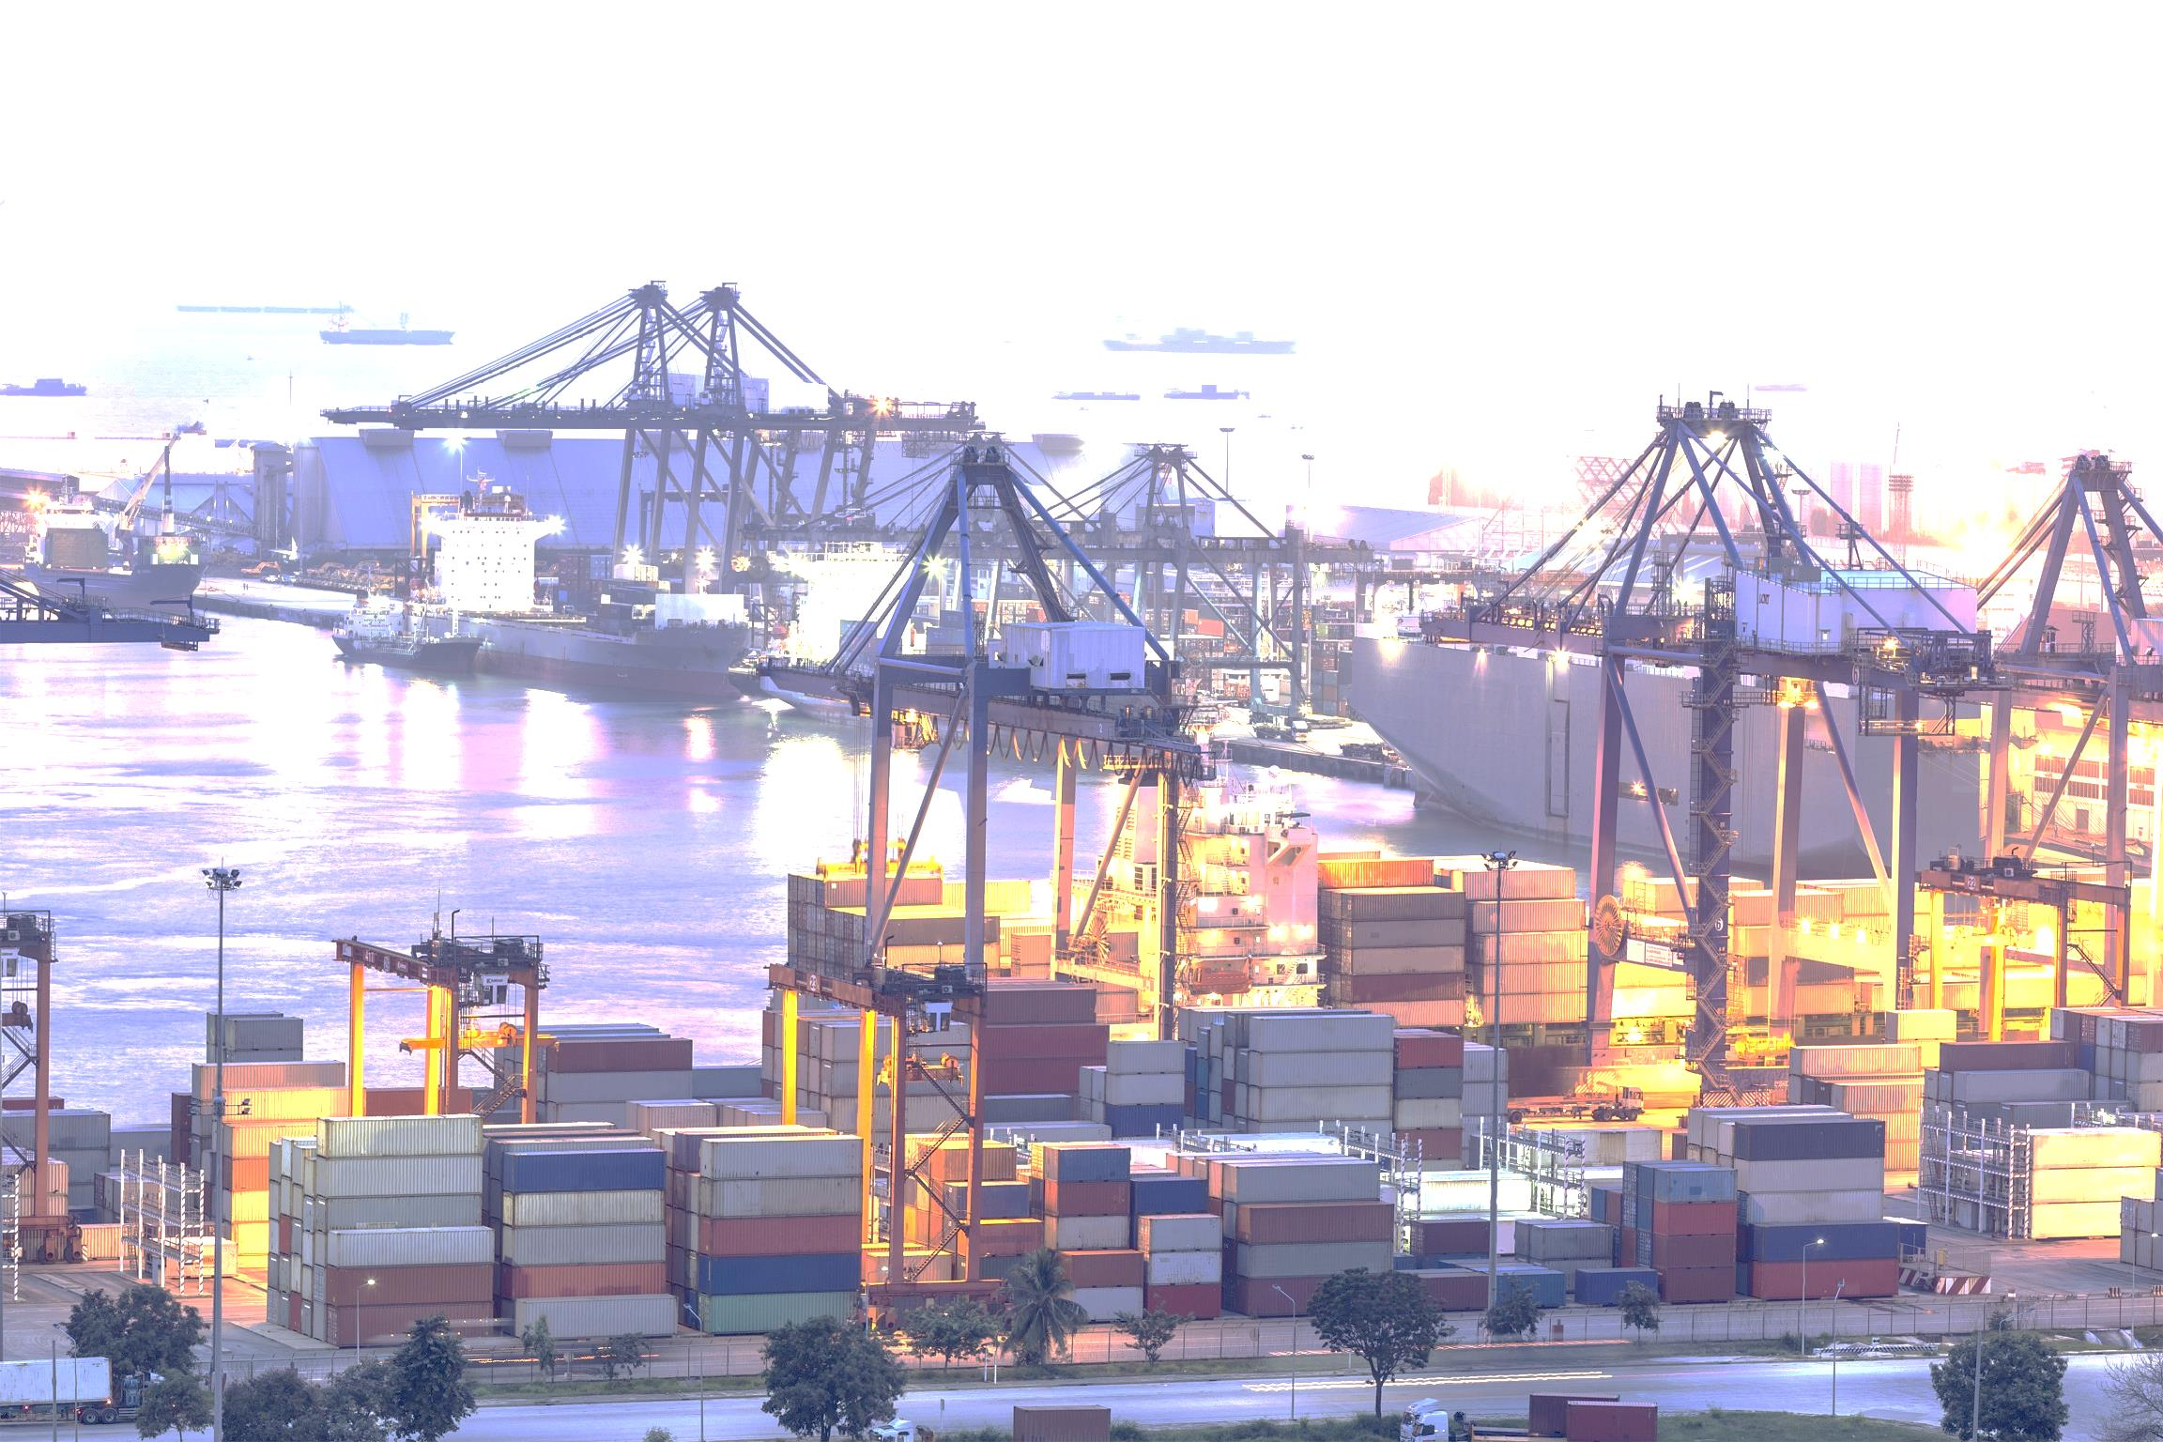
An evolution of the global trade landscape
Progressive elimination of traditional barriers to trade
Higher interdependence among national & regional economies
An increasing role for standards as trade enablers, creating a level-playing field
First beneficiaries: SMEs
Notes:
The way the global trade landscape evolves increases the role of standards
What is happening:
Elimination of traditional barriers to trade
Relative progress achieved in multilateral trade discussions, WTO
Multiplication of bilateral/multilateral free-trade agreements (WTO figures: 124 Trade Agreements in the period 1948-1994 – 46 yrs, over 400 between 1995 & 2012 – 17 yrs)
Higher interdependence between economies
Steady increase of the share of trade (export/import ) in relation to all countries’ GDP
Global Value Chain concept => increased need for a common language to help working together
Increased role of standards
Playing the role of trade enablers (interoperability, compatibility, trust, etc.)
Supporting fair competition in global trade, thanks to agreed common specifications

Slide 3
CEN & CENELEC approach in support of European companies’ competitiveness Fostering coherence at all levels
European engagement in ISO & IEC
CEN and CENELEC alignment with ISO & IEC, fostering the worldwide adoption of ISO & IEC standards
Dissemination of ‘home-grown’ ENs
(complementary tool for technical alignment)
Partnerships & projects supporting strategic cooperation and technical alignment (through ISO/IEC first)
Involvement in EU regulatory dialogues & trade negotiations (promoting of the model)
Notes:
Industry and businesses do not like doing the same work twice…
In Europe, national delegation & commitment => 1 EN = 33 XX ENs + withdrawal of conflicting standards
Whenever possible, going for ISO/IEC solution (good for competitiveness of European manufacturers in global markets + openness of European market)
This slide shows the overall coherence fostered by CEN and CENELEC throughout their technical + international cooperation work

Slide 4
SBS liaisons with ISO Committees
ISO/TC 178 | Lifts, escalators and moving walks
ISO/TC 211 | Geographic information/Geomatics
ISO/TC 217 | Cosmetics
ISO/TC 228 | Tourism and related services
Notes:
European SMEs are represented at ISO level in these 4 TCs through laision agreements. SBS is observer in these meetings

Slide 5
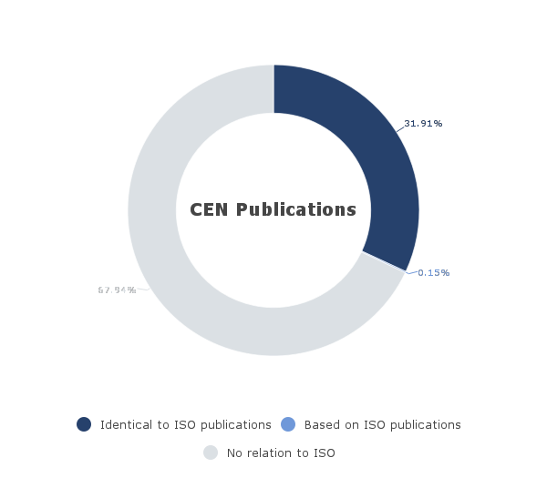
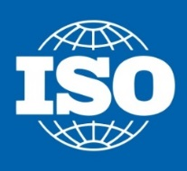
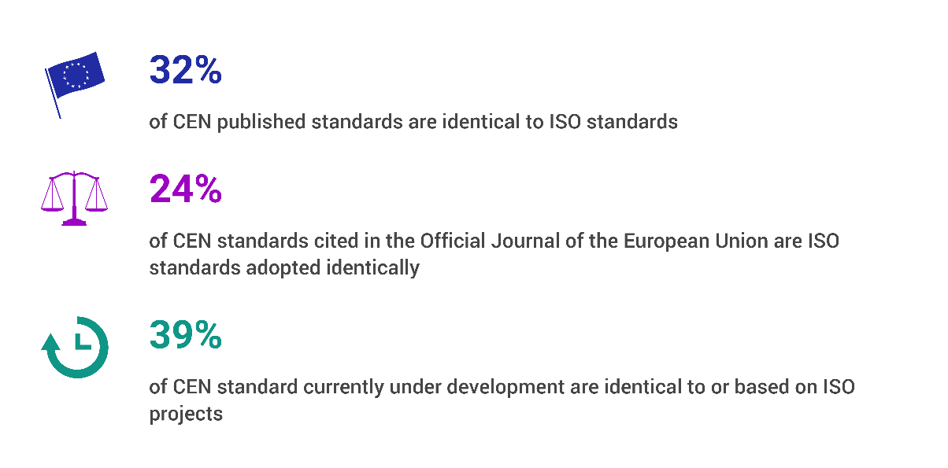
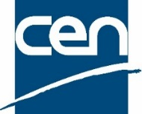
CEN and CENELEC alignment with ISO/IEC Walking the talk
Source: CEN-CENELEC Statistics at end Q2 2016
Notes:
Alignment with ISO & IEC fundamental to support the global competitiveness of European industry!

Slide 6
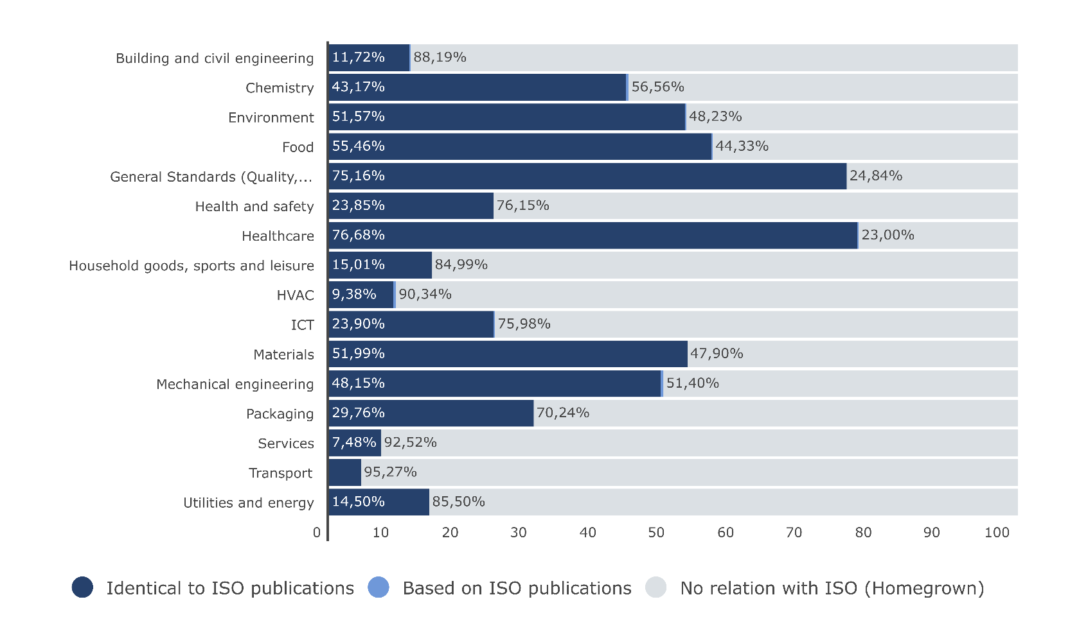
Benefits for Businesses
Global markets => international standards
Source: CEN-CENELEC Statistics at end Q2 2016
Notes:
Figures from end Q2 2016
International standards support global market access => alignment with ISO & IEC fundamental to support the global competitiveness of European industry and SMEs!
The more global the market, the higher the alignment

Slide 7
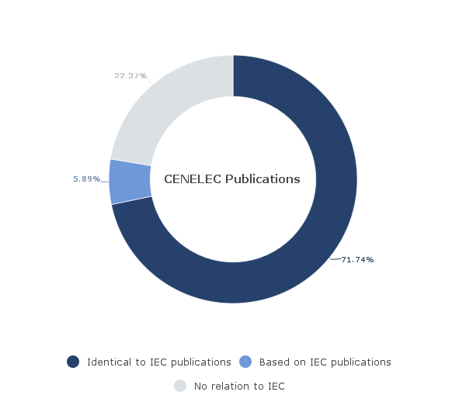
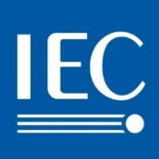
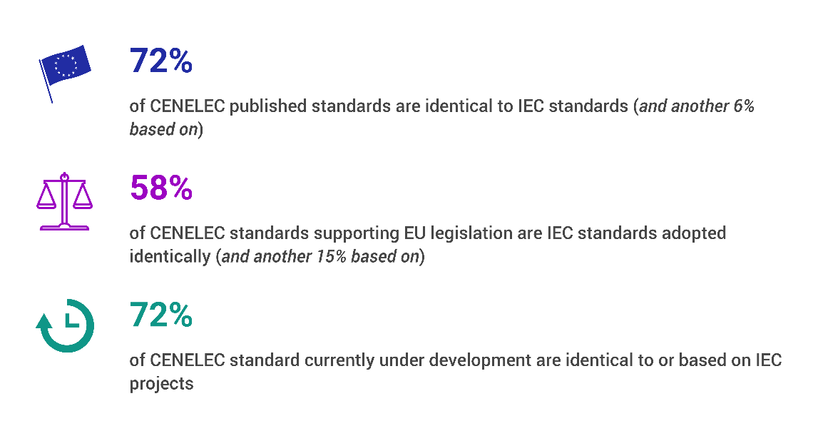
CEN and CENELEC alignment with ISO/IEC Walking the talk
Source: CEN-CENELEC Statistics at end Q2 2016
Notes:
Alignment with ISO & IEC fundamental to support the global competitiveness of European industry!

Slide 8
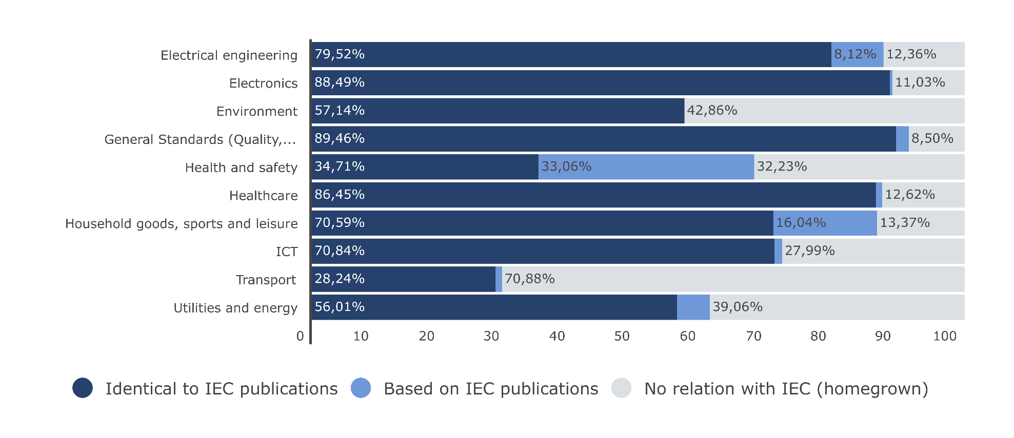
Benefits for Businesses
Global markets => international standards
Source: CEN-CENELEC Statistics at end Q2 2016
Notes:
Figures from end Q2 2016
International standards support global market access => alignment with ISO & IEC fundamental to support the global competitiveness of European industry and SMEs!
The more global the market, the higher the alignment

Slide 9
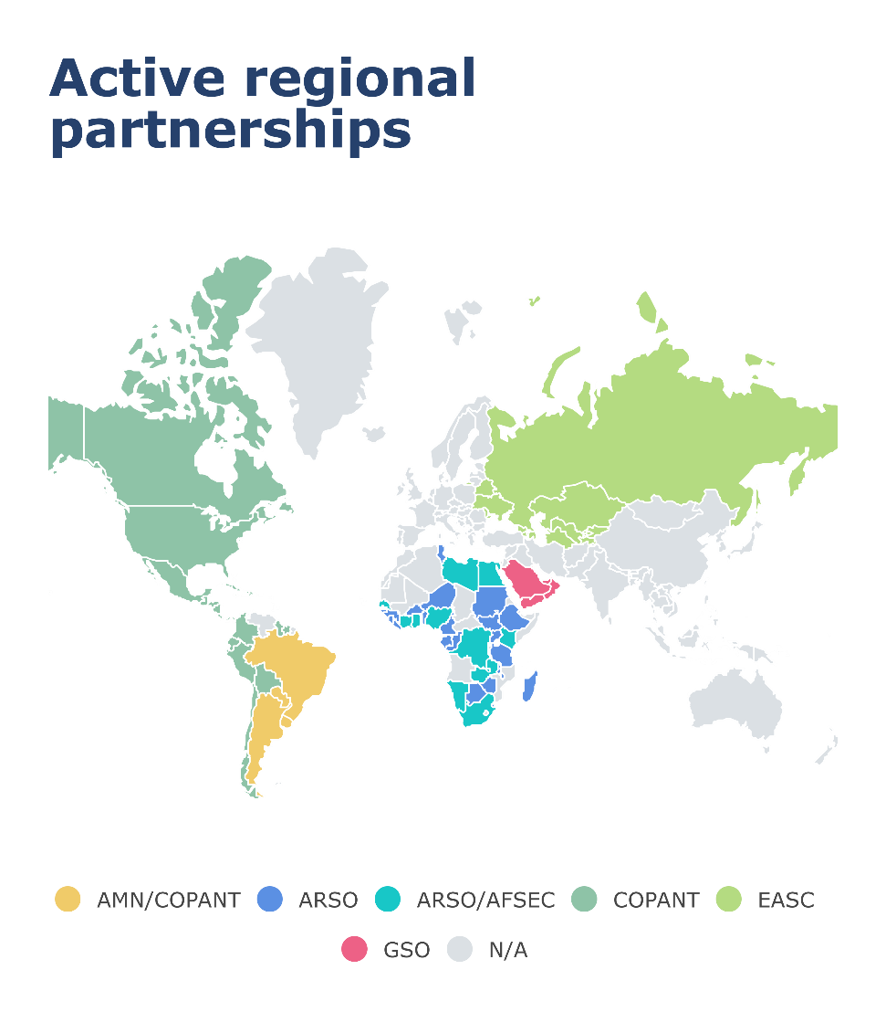
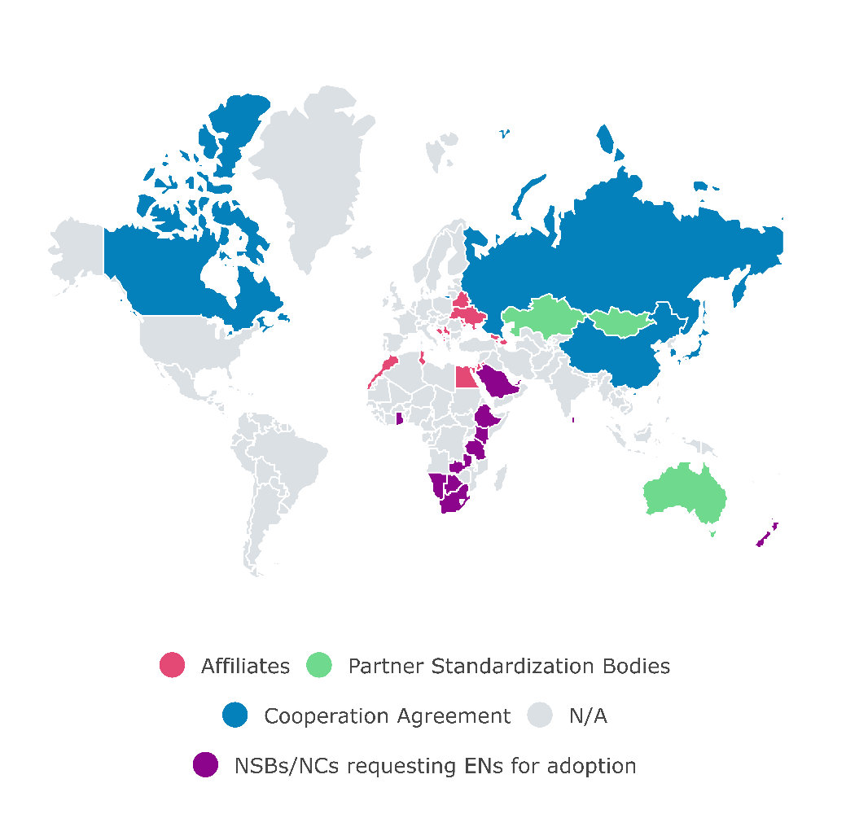
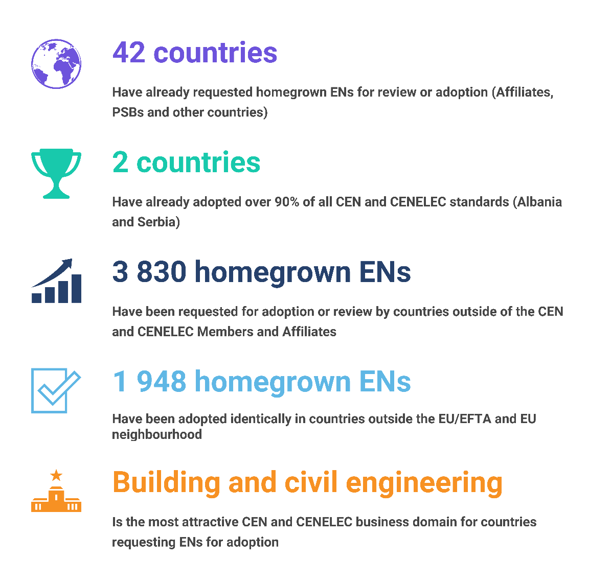
Fostering alignment via the identical adoption of ENs A complementary tool supporting market access
Source: CEN-CENELEC Statistics at end Q2 2016
Notes:
On the right appear the channels enabling the adoption of ENs (Affiliate & PSB statuses, cooperation agreements + license agreements)
On the left some facts and figures from Q2 2016
Numerous channels (complementary to the strong connection with ISO/IEC) to spread European know-how and technological leadership, and to foster the European standardization model (NLF and New Approach, national delegation and commitment, high engagement in / alignment with ISO & IEC):
16 Affiliates of CEN and/or CENELEC (from Morocco to Azerbaidjan) => expanding the benefits of the European standardization model (access to ENs for adoption, access to TC work as observer, compulsory withdrawal of conflicting standards)
3 PSBs (Australia, Kazakhstan, Mongolia) => expanding the benefits of the European standardization model (access to ENs for adoption, access to TC work as observer, compulsory withdrawal of conflicting standards)
5 Cooperation Agreements with NSBs (Canada, China, Japan, Korea, Russia) fostering the European standardization model (New Approach principles, primacy to ISO/IEC, single standard model) and supporting exchanges of views on technical issues / technical cooperation
10 MoUs (6 active ones: AMN & COPANT in the Americas, ARSO & AFSEC in Africa, EASC covering the Eastern Partnership countries, GSO covering the Gulf region) => fostering the European standardization model (New Approach principles, primacy to ISO/IEC, single standard)
27 countries that already requested ENs for adoption/review outside Europe+neighbourhood (18 that already adopted Ens) => acknowledging + supporting the European technological leadership in other countries

Slide 10
Thank you!
www.cen.eu
www.cenelec.eu
www.cencenelec.eu
Follow us on:

