Slide 1
ADR: a potential tool for SMEs for standards related disputes
SBS – WIPO Seminar
Brussels, 22nd January 2019
Luc Hendrickx

Slide 2
Who we are
SMEunited is the association of Crafts and SMEs in Europe
Mission: shaping Europe for SMEs and shaping SMEs for Europe
Recognised employers’ organisation and European Social Partner
Represent the interest of SMEs towards European Institutions
Not-for-profit and non-partisan

Slide 3
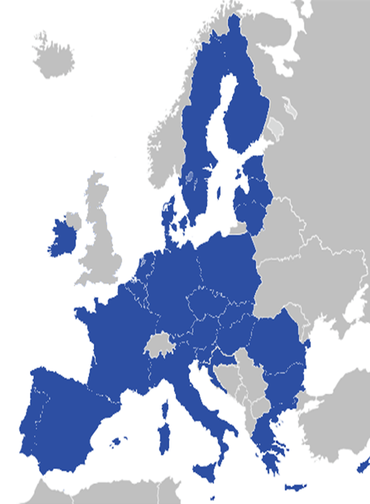
Who we represent
70 member organisations
Over 30 countries
Around 12 million enterprises
Around 55 million employees
Co-founder SBS

Slide 4
What we do
Regulatory monitoring
Advocacy
& lobbying
Capacity building
Projects

Slide 5
SMEs and access to justice
Survey Sept 2017 (UNIZO - Belgium)
4 out of 10 (42%) entrepreneurs went to court the last 5 years
22% once – 13% 2-3 times - 4% 4-5 times - 3% 6 times or more
46% satisfied with procedure before court (depends on court!)
Would you go to court again: 28% yes - 18% no - 54% depends on the case
Main barriers: uncertain procedure (44%), cost lawyer (10%), too long (31%) and expensive (10%) procedures

Slide 6
SMEs and ADR
Survey Sept 2017 (UNIZO - Belgium)
Only 2 out of 10 (21%) used already arbitration (5%)/mediation (12%) - (4% both)
44% satisfied with the procedure of arbitration/mediation
Lack of legal security (26%), too expensive(12%), too complex (8%)…
Would you use it again: yes (25%) – court (9%) – 5% none of these options – 60% : depends on the case
Non –users: 48% entrepreneurs would prefer arbitration/mediation above court for future disputes
70% does not know ADR enough; court offers more legal security (13%); court is faster (5%) or less expensive (3%)

Slide 7
Advantages of arbitration
Fast – parties decide themselves on the timeframe - no appeal
Flexible: procedure (e.g. written), place, time, language, rules of procedure
Confidentiality and secrecy (behind closed doors, no publicity)
Better for long-time relationship
Legally binding mediation
Cost can be high

Slide 8
Good practice: EURid
Possibility to challenge a .eu registration if you have a prior right to the domain name and the current holder has registered the domain name for speculative or abusive purposes
Can be initiated without the assistance of a legal representative
No travel required – conducted online and by e-mail in the 24 official EU languages
In the language of the domain name holder unless agreed otherwise. As a complainant, you can request a change to another official EU language.

Slide 9
Good practice: EURid
Are resolved by independent panellists, not judges. The panellists are often intellectual property experts
200 accredited international experts
An average of 4 months to resolve
CAC (Czech Arbitration Court) appointed in 2005 –WIPO in 2016
Discounted fees:
For CAC: http://eu.adr.eu/adr/fees/index.php
For WIPO Center: http://www.wipo.int/amc/en/domains/fees/

Slide 10
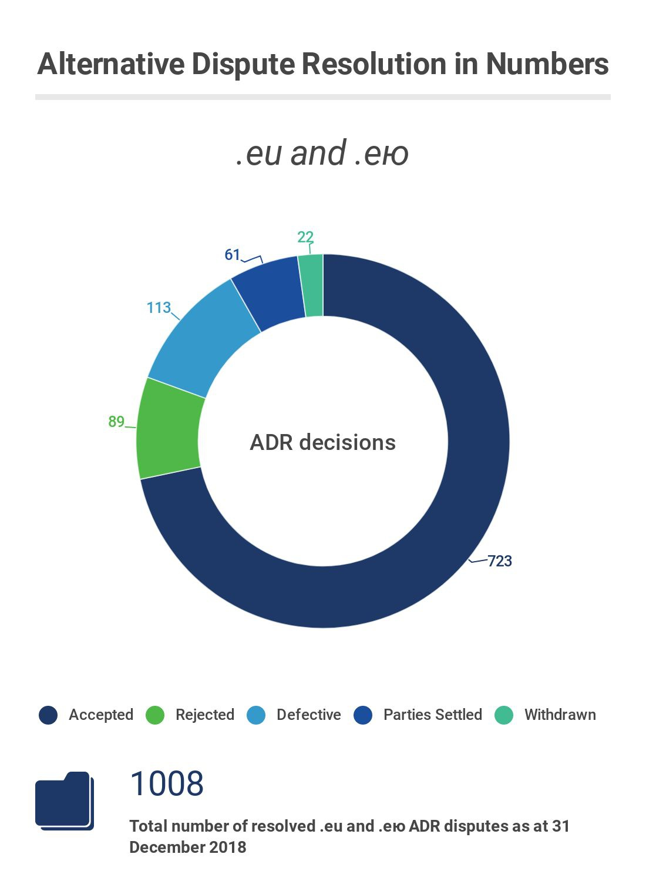

Slide 11
Conclusions
ADR needs to remain strictly voluntary
Knowledge of businesses and consumers on available ADR schemes must be raised – use increased
Better information on how it works, obligations and costs
Should be no language limitations

Slide 12
Thank you for your attention!
l.hendrickx@smeunited.eu

