Slide 1
CEN and CENELEC SMEs-friendly policies
Opportunities and challenges for SMEs

Slide 2
Summary
SMEs participation CEN-CENELEC standardization work
Drafting standards considering SMEs needs
Raising awareness on the use of standards by SMEs
CEN and CENELEC Patent policy

Slide 3
~500 TCs
450 CEN - 50 CENELEC
~2.000 WGs
Electric Vehicles
Electromagnetic Compatibility
Fibre optic Communications
Fuel Cells
Household appliances
ICT
Interoperability
Medical Equipment
Railways
Smart grids
SmartHouse
Smart metering

Slide 4
SMEs participation in CEN-CENELEC standardization work
Affiliates
EC
Europe
CEN - CENELEC
Partners
EFTA
SBS
National
NSB
NSB
NSB
NSB
NSB
NSB
NSB
NSB
NSB
NSB
Standards Users
Trades Unions
Professional institutions
Consumer Bodies
Government
Departments
Educational
Bodies
Research
Organizations
Certification
Bodies
SMEs
Enforcement
Bodies

Slide 5
Drafting standards considering SMEs needs
CEN-CENELEC Guide 17 for writing standards taking into account SMEs needs
SME needs considered in the standard development process:
Preparation of a New Work Item
Preparation of a Standard
Developing the content of the standard
Structure and presentation of the content
Final Review
Notes:
a) Considerations for the development of standards that are best adapted to the SMEs needs;
b) Techniques for identifying and assessing provisions in standards that may especially impact SMEs;
c) Ways to reduce negative impacts on SMEs resulting from some provisions in standards;
d) Guidelines for writing SME friendly standards;
e) Guide checklist;
f) Information on how to make a micro enterprise impact of new standards

Slide 6
Drafting standards considering SMEs needs
CEN-CENELEC Internal Regulations Part 3
Mention of Trademarks to be avoided
Description of products is preferred
No advantage to specific products and suppliers
Level playing field for all, including SMEs

Slide 7
Raising awareness on the use of standards by SMEs
Help SMEs to better understand
How using standards can benefit business
How to identify the right standards
How to get support from national CEN and CENELEC members and
How to shape the content of future standards
Notes:
Show and explain the importance and the benefits of standardization
Access to information about standards and related activities
Develop services for SMEs and ensure their participation
The SME Toolbox gives SMEs a better understanding of how using standards can benefit your business, how you can identify the right standards, how to get support from your national CEN and CENELEC members and how to shape the content of future standards.

Slide 8
CEN and CENELEC Patent policy
Collaborative approach in standards development
Patented technologies can be incorporated in standards
Balancing of interests

Slide 9
CEN-CENELEC Patent policy
CEN-CENELEC Guide 8 on Implementation of the Common Policy on Patents
Based on ISO/IEC/ITU common patent policy
Voluntary early declarations “at the best of experts’ knowledge”
Essentiality
Examine relevance of declared patents, but NOT scope, validity & terms
FRAND conditions (Fair, Reasonable And Non Discriminatory)

Slide 10
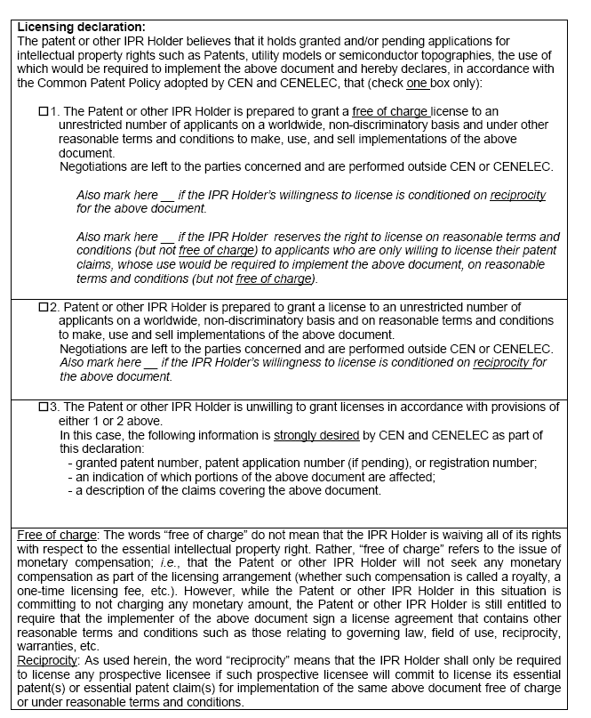
The declaration
Patent granted “free of charge”
Patent granted € at FRAND conditions
Patent not granted

Slide 11
CEN and CENELEC Patent policy
Patent Declaration
Patent list provided on the CEN and CENELEC websites
Commitment of the patent holders to license
Ability of design-around
Avoid patented technologies
Possibility to consider other technologies

Slide 12
CEN and CENELEC Patent Policy
CEN and CENELEC Position paper
Confirms existing rules:
Indispensable to commit to FRAND conditions
NO CEN-CENELEC role to assess patent essentiality
NO interference with licensing negotiations
Clarifies:
FRAND: NO pricing content, but a “comity device” designed to promote good faith negotiation
DO NOT support initiatives to provide guidance on, or impose compliance with, FRAND pricing, valuation and rate-setting methodologies

Slide 13
“The expression of beauty is in direct ratio to the power of conception the artist has acquired”
Gustave Courbet

Slide 14
Thank you!
Spiro Dhapi
Project Manager - Legal Affairs
sdhapi@cencenelec.eu

