Slide 1
European Federation for Elevator Small and Medium-sized Enterprises
EFESME
22 September 2016
Madrid, Spain
Massimo Bezzi – Vice President

Slide 2
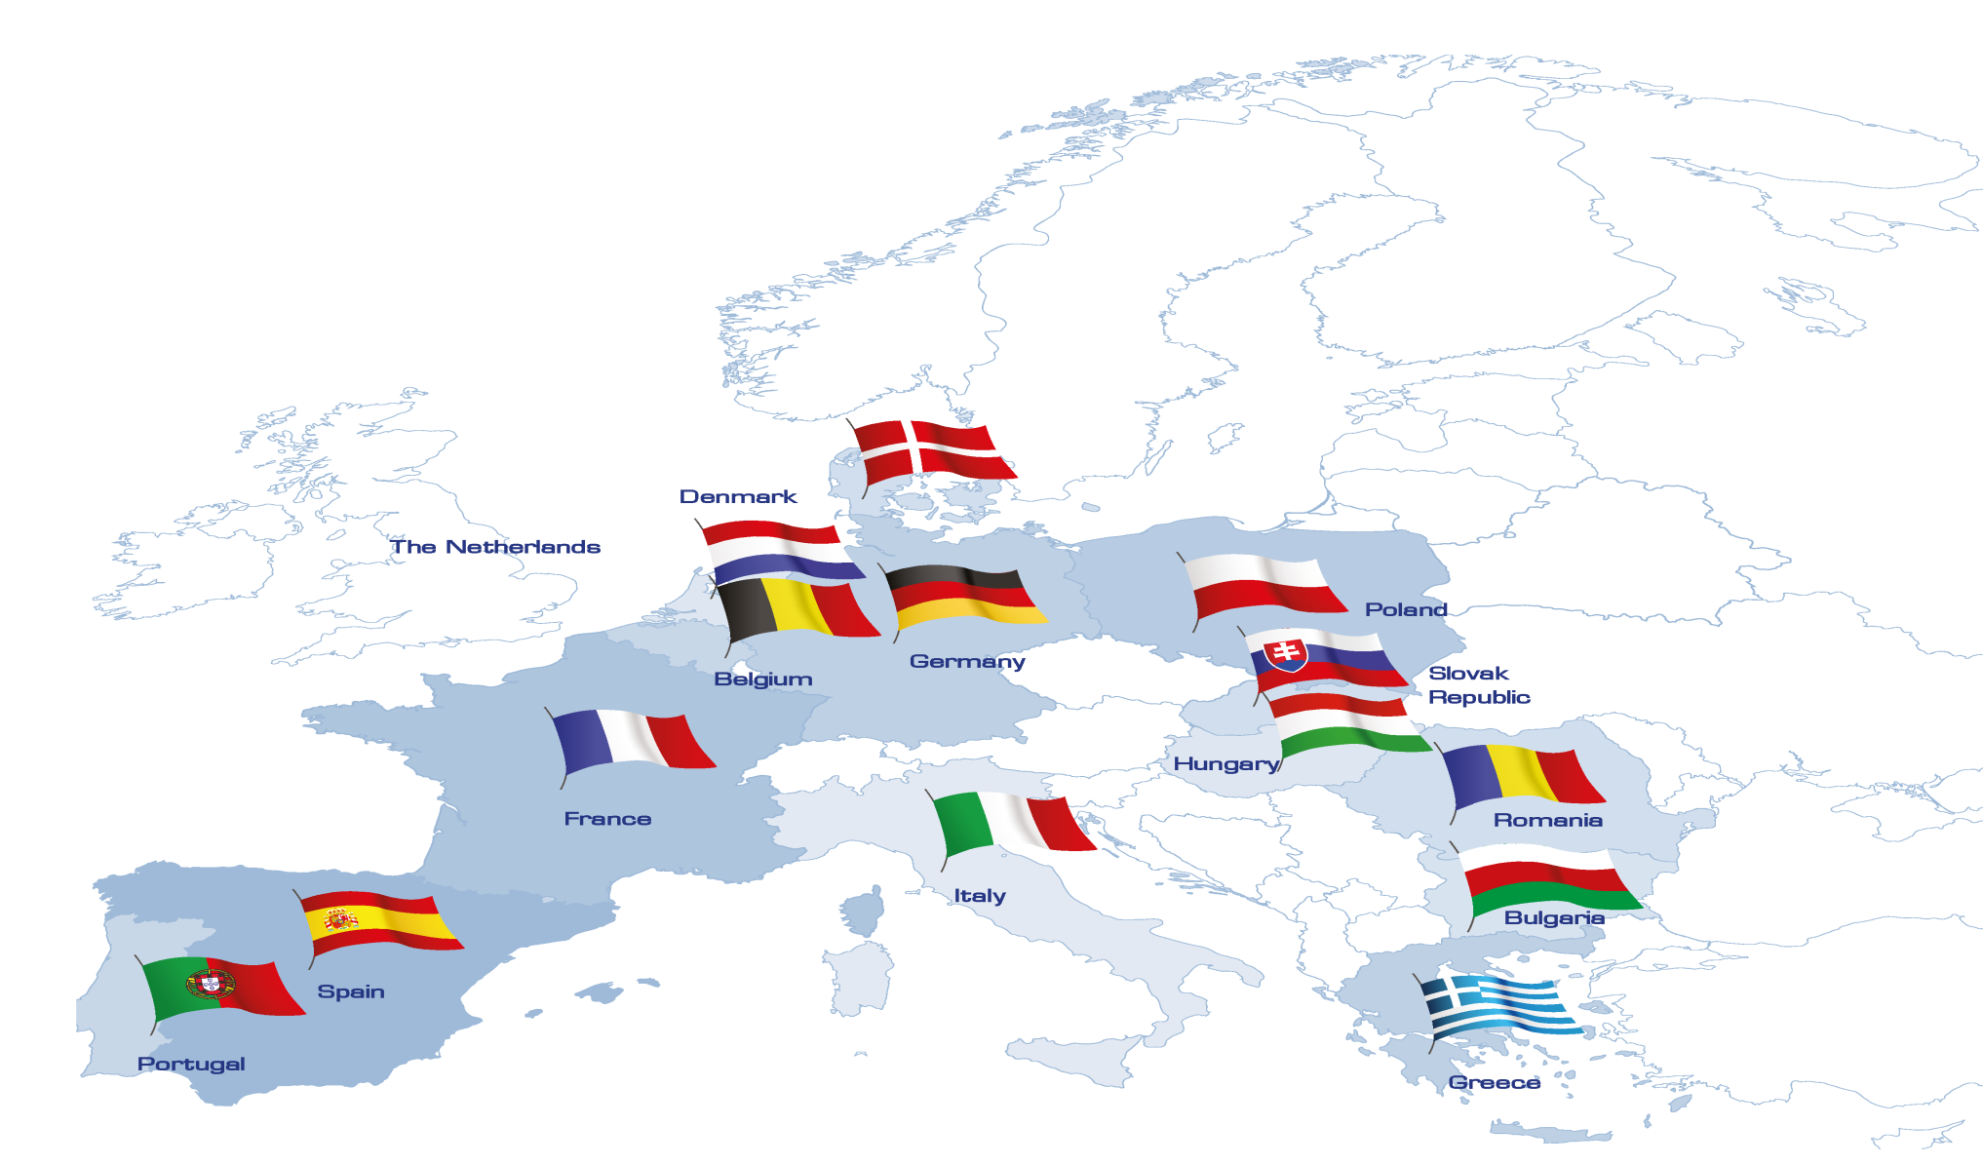
What is EFESME?
EFESME aisbl – European Federation for Elevator Small and Medium-sized Enterprises, 6, Rond-Point Schuman, B-1040 Brussels, Belgium
Tel: +32 2 230 7414 – Email: efesme@efesme.org – www.efesme.org

Slide 3
What is EFESME?
Protecting SMEs in the lift sector at EU level since 2005
15 associations from 14 countries
Participating in CEN TC10, ISO TC178, EC Lift Working Group
Funding Member of SBS and Member of UEAPME
EFESME aisbl – European Federation for Elevator Small and Medium-sized Enterprises, 6, Rond-Point Schuman, B-1040 Brussels, Belgium
Tel: +32 2 230 7414 – Email: efesme@efesme.org – www.efesme.org

Slide 4
www.efesme.org
secretariat@efesme.org

