Slide 1
European Federation for Elevator Small and Medium-sized Enterprises
EFESME Activities 22 September 2016
Madrid - Spain
Massimo Bezzi – Vice President

Slide 2
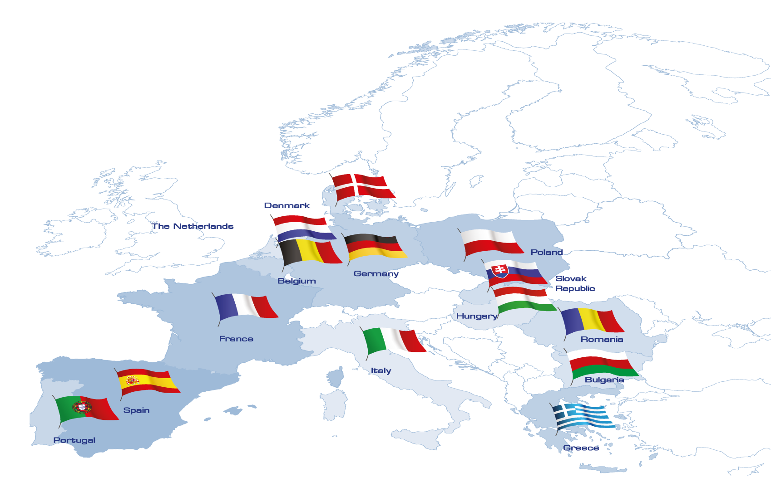
EFESME 2016 Representing 14 Member States
EFESME aisbl – European Federation for Elevator Small and Medium-sized Enterprises, 6, Rond-Point Schuman, B-1040 Brussels, Belgium
Tel: +32 2 230 7414 – Email: efesme@efesme.org – www.efesme.org

Slide 3
EFESME CHART ORGANIZATION
Mr. Marcel BOUTTILIER President
Mr. Massimo BEZZI Vice-President
Mr. Ralph KANZLER Vice-President
Mr. Giuseppe IOTTI Secretary General
Mr. Bruno VENDITTI Treasurer
Ms. Giorgia CAPASSO
Ms. Alice LAZIOLI
Office - Brussels
EFESME aisbl – European Federation for Elevator Small and Medium-sized Enterprises, 6, Rond-Point Schuman, B-1040 Brussels, Belgium
Tel: +32 2 230 7414 – Email: efesme@efesme.org – www.efesme.org

Slide 4
Cooperation with other associations
Lobbying actions, consultations, position papers with SBS and UEAPME collaboration
EFESME is founding member of SBS - Small Business Standard founded in 2013
The Mission of SBS
The SBS mission is to represent and defend SME interests in the standardisation process at European and international level. Moreover, it aims at raising SME awareness about the benefits of standards and at encouraging them to get involved in the standardisation process
EFESME aisbl – European Federation for Elevator Small and Medium-sized Enterprises, 6, Rond-Point Schuman, B-1040 Brussels, Belgium
Tel: +32 2 230 7414 – Email: efesme@efesme.org – www.efesme.org

Slide 5
Cooperation with other associations
Memorandum of Understanding with ELA (February 2016)
Participation in ELA working groups (Energy & Ecology, PCR for Lifts Follow-Up Task Force, Lift Directive and Code & Standards, Education & Training, Accessibility)
Collaboration with ELCA
EFESME aisbl – European Federation for Elevator Small and Medium-sized Enterprises, 6, Rond-Point Schuman, B-1040 Brussels, Belgium
Tel: +32 2 230 7414 – Email: efesme@efesme.org – www.efesme.org

Slide 6
Technical activities
European Committee for Standardization (CEN) CEN TC10 meetings attended by Mr Giuseppe Iotti
International Organization for Standardization ISO TC178 meetings attended by Mr Luciano Faletto
Iotti – CEN TC10 | Faletto – ISO TC178
WG1 - Safety of Lifts WG10 - Safety of Existing lifts LWG - Lift Working Group (Standing Committee) | WG 4 - Safety requirements and risk assessment WG 4-TFC - Task force convergence WG 6 - Lift installation, dimensions and evacuation WG 6-SC1 - Lift dimensions WG 6-SC2 - Fire testing WG 6-SC2 - Controls including disabilty WG 6-SC2 - Evacuation lifts WG 10 - Energy efficiency
EFESME aisbl – European Federation for Elevator Small and Medium-sized Enterprises, 6, Rond-Point Schuman, B-1040 Brussels, Belgium
Tel: +32 2 230 7414 – Email: efesme@efesme.org – www.efesme.org

Slide 7
Promotional activities
Bimonthly newsletter
Seminars organisation
International exhibitions participation (Asansor in Istanbul, Russian Elevator Week in Moscow, Interlift in Augsburg, Italia Eleva in Rome)
Communication through social medias and website
New member (Bulgaria, July 2016)
EFESME aisbl – European Federation for Elevator Small and Medium-sized Enterprises, 6, Rond-Point Schuman, B-1040 Brussels, Belgium
Tel: +32 2 230 7414 – Email: efesme@efesme.org – www.efesme.org

Slide 8
Thank you for your attention
www.efesme.org
secretariat@efesme.org

