Slide 2
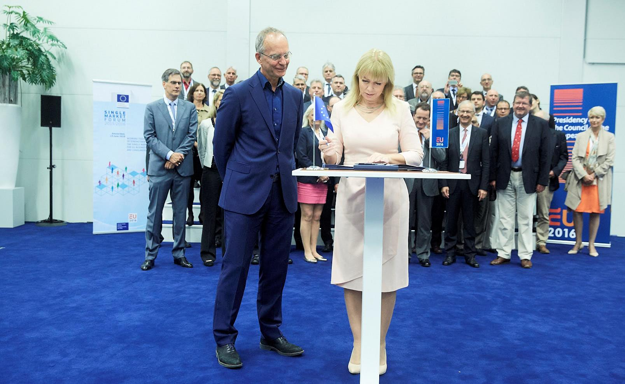
Notes:
Best Hollywood movies begin with the end.
Here is the plot.

Slide 3
Standardisation = ±1% GDP
€6.2 billion
Notes:
Cost on non-EU (EP study updated 2015)
Standardisation = about €6.2B

Slide 4
The golden rule
1>28

Slide 5
European Standards for the 21st Century

Slide 6
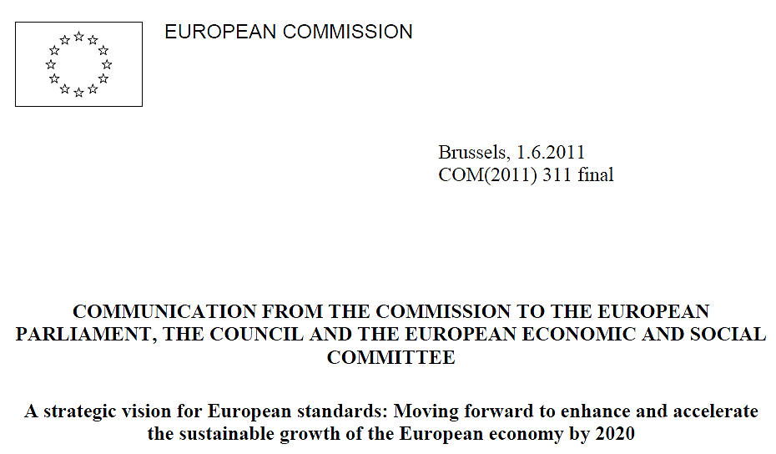
5

Slide 7
4
Chapeau Communication
Annual Union Work Programme
2017
1 June 2016
Services
REFIT

Slide 8
Annual Union Work Programme for European Standardisation 2017
15
32
22

Slide 9
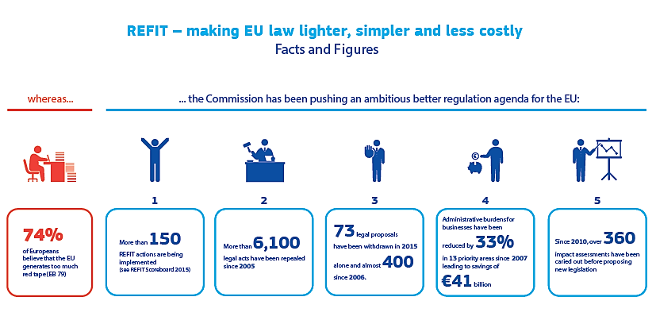
+ Article 24 Report, 2013-2015

Slide 10
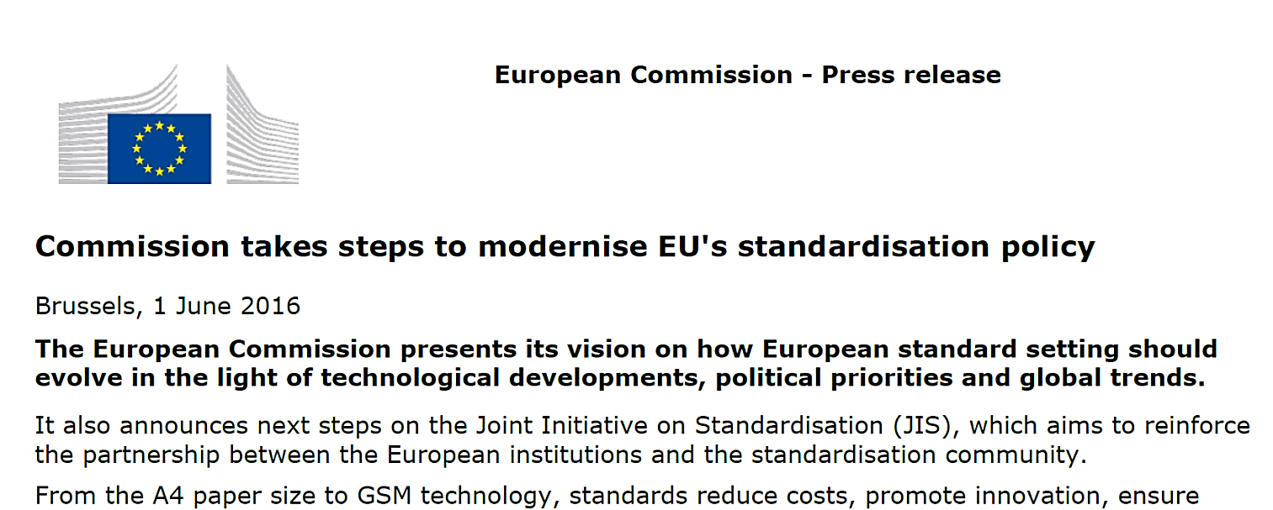

Slide 11
Standards together:
a single platform serving multiple policies.
Standards in support of policies that cut across the economy:
products, services and ICT.

Slide 12
Service standards

Slide 13
Why dedicated guidance on service standards?
1
Underdevelopment of European service standards
(services = 70% of the EU economy, service standards ≈ 2% of all European standards)
2
Increase in barriers from national service standards, especially where they turn into mandatory national certification requirements
(only ~15% of service standards in Europe are European standards)

Slide 14
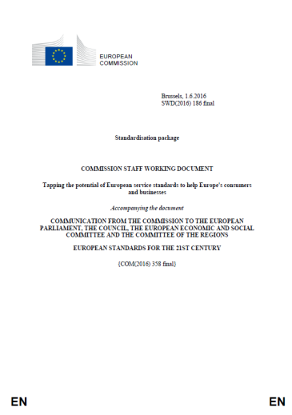
Scoping the issues
service standards = ≈ goods standards
=
≠
Voluntary
Market-driven
Based on consensus
The same process
Inherent differences between goods and services
Differences in markets and integration
Different approach in EU legislation – less sectoral
Benefits from greater development and use of European service standards
National barriers

Slide 15
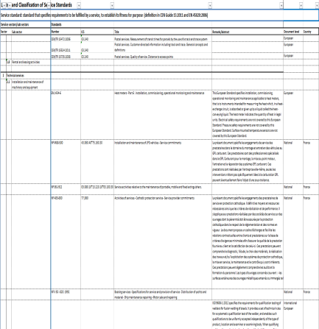
What is proposed
Development of European standards
Mapping of standards
Identification of areas
Prioritisation of areas
Development of standards
criteria
Standardisation requests
Recommendation to European Standardisers
???
???

Slide 16
Joint Initiative on Standardisation

Slide 17
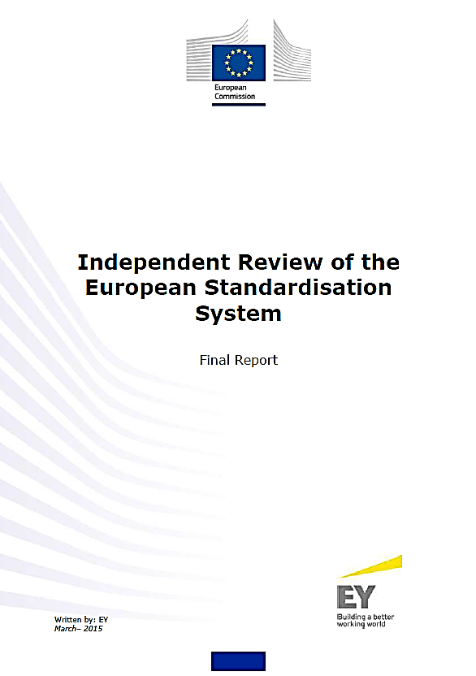

Slide 18
COM(2015) 550 final
SWD(2015) 202 final

Slide 19
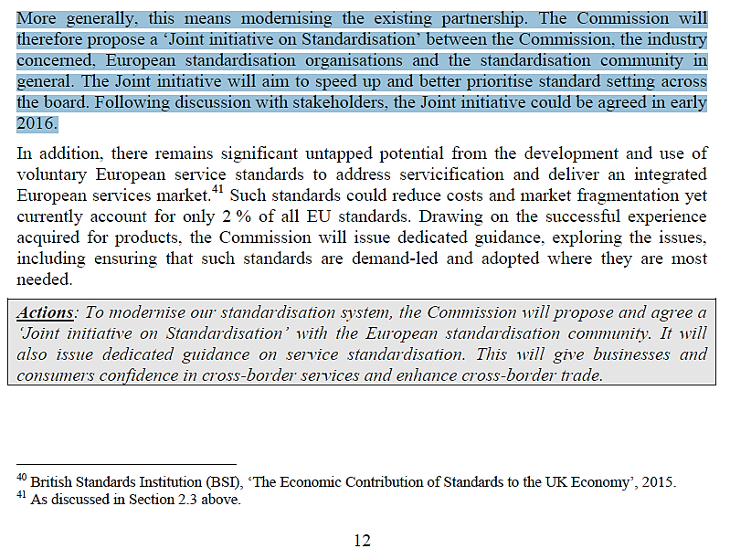

Slide 21
GROW-JOINT-INITIATIVE@ec.europa.eu

